Slide 1
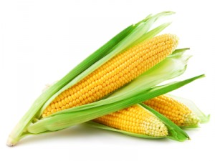
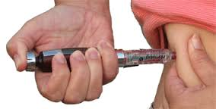
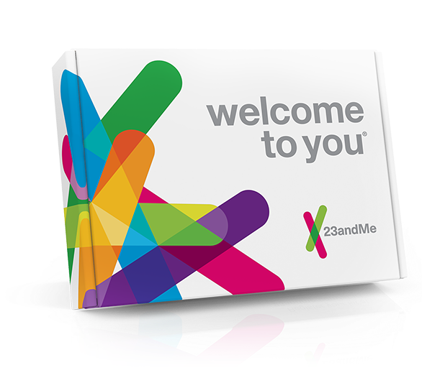
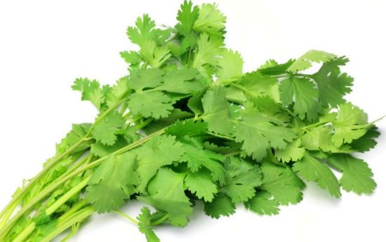
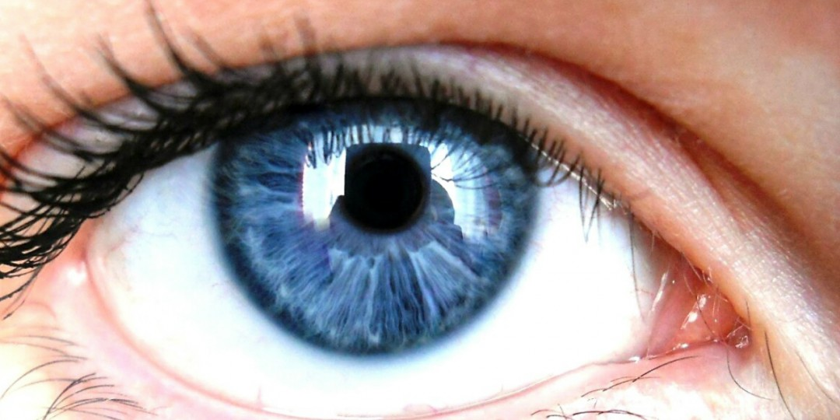
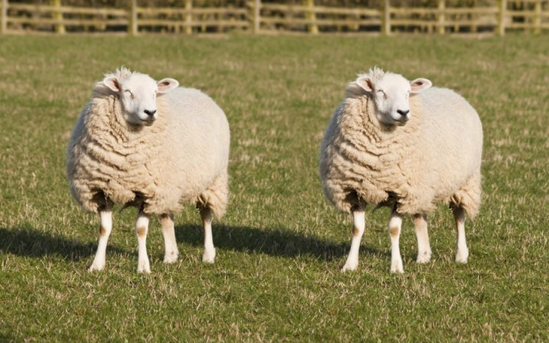
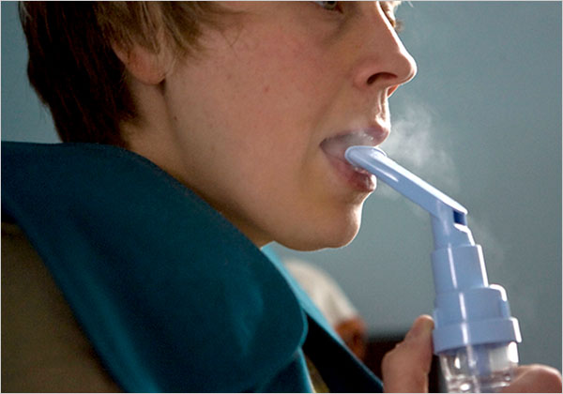
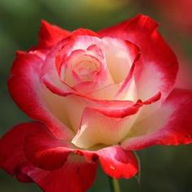

Slide 2
Genetics

Slide 3
DNA
What does DNA stand for?
Where is it found?
What are the building blocks of a DNA molecule? (Clue: bases)
How would you describe the structure?

Slide 4
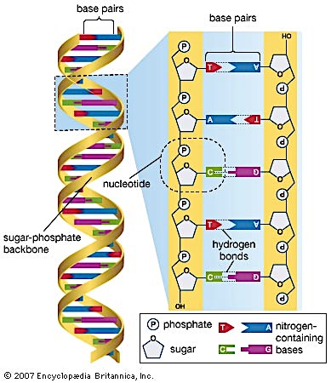

Slide 5
Genes
Where are genes found?
What are genes made of?
What is the function of a gene?

Slide 6
Chromosomes
What are chromosomes made of?
How many chromosomes are found in human cells? Is it the same for all cells?
What is the relationship between chromosomes, DNA and genes?

Slide 7
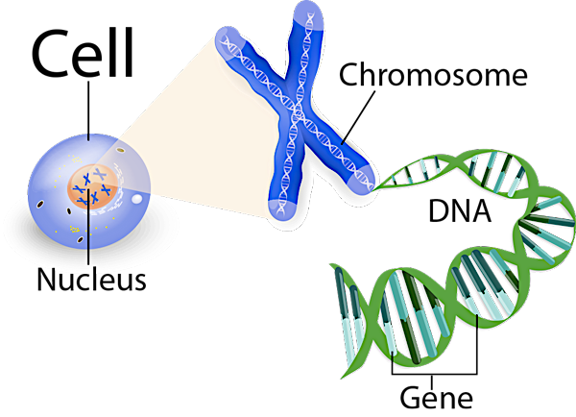

Slide 8
Alleles
What are alleles?
What is a dominant allele? What is a recessive allele? And how is it represented?
What does it mean to be heterozygous?
What about homozygous?

Slide 9
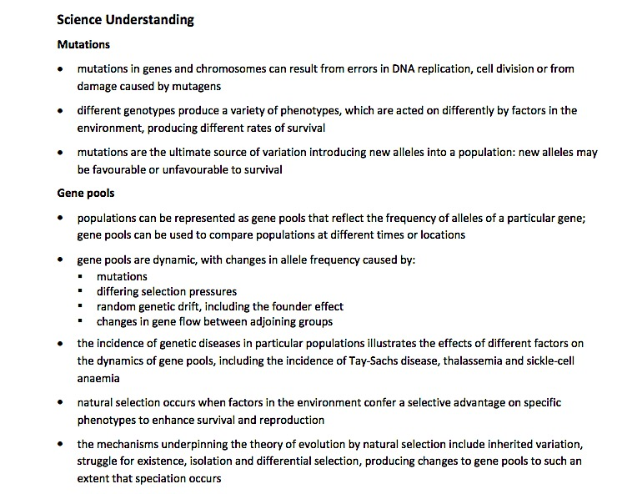

Slide 10


Population
A population is a group of organisms of the same species living together in a particular place at a particular time

Slide 11
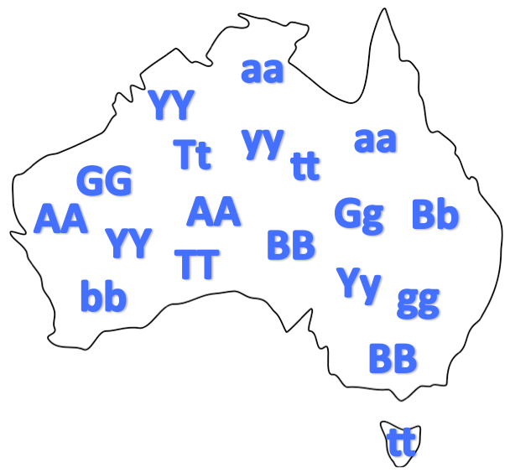
Gene pools
The sum of all alleles in a given population

Slide 13

Mutations
A permanent change in a gene or chromosome that could potentially lead to a new characteristic in an organism

Slide 14
Mutations
A permanent change in a gene or chromosome, potentially leading to a new characteristic in an organism
Mutant
organism with a characteristic resulting from a mutation
Two main types of mutations
Gene & chromosomal
Can occur randomly or can be induced

Slide 15
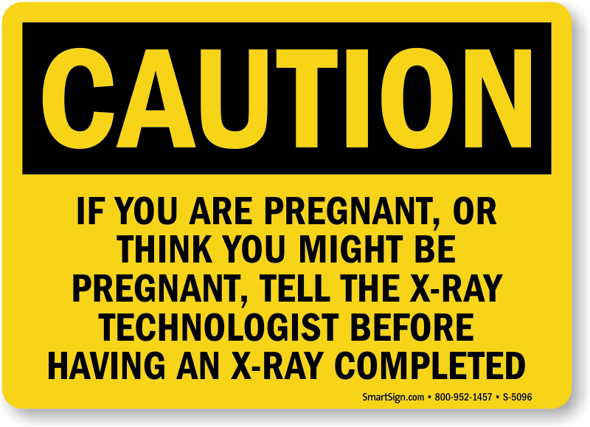
Mutagens
Mutagens/mutagenic agents
increase the rate of mutations

Slide 16
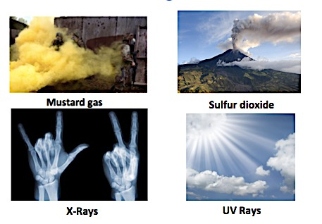
Mutagens

Slide 17
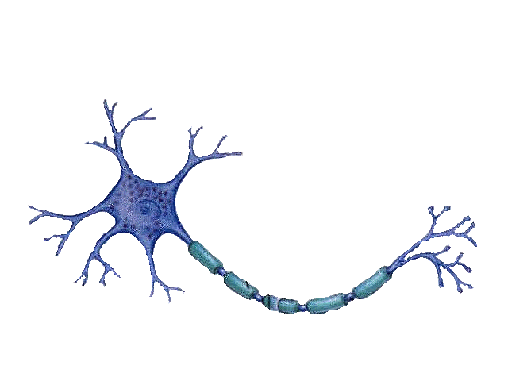
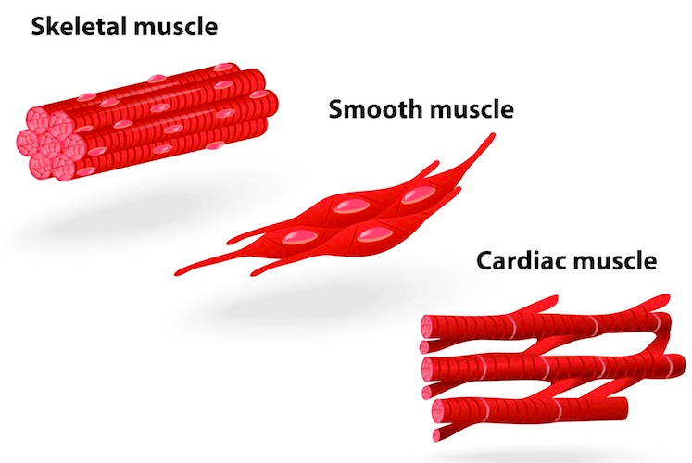
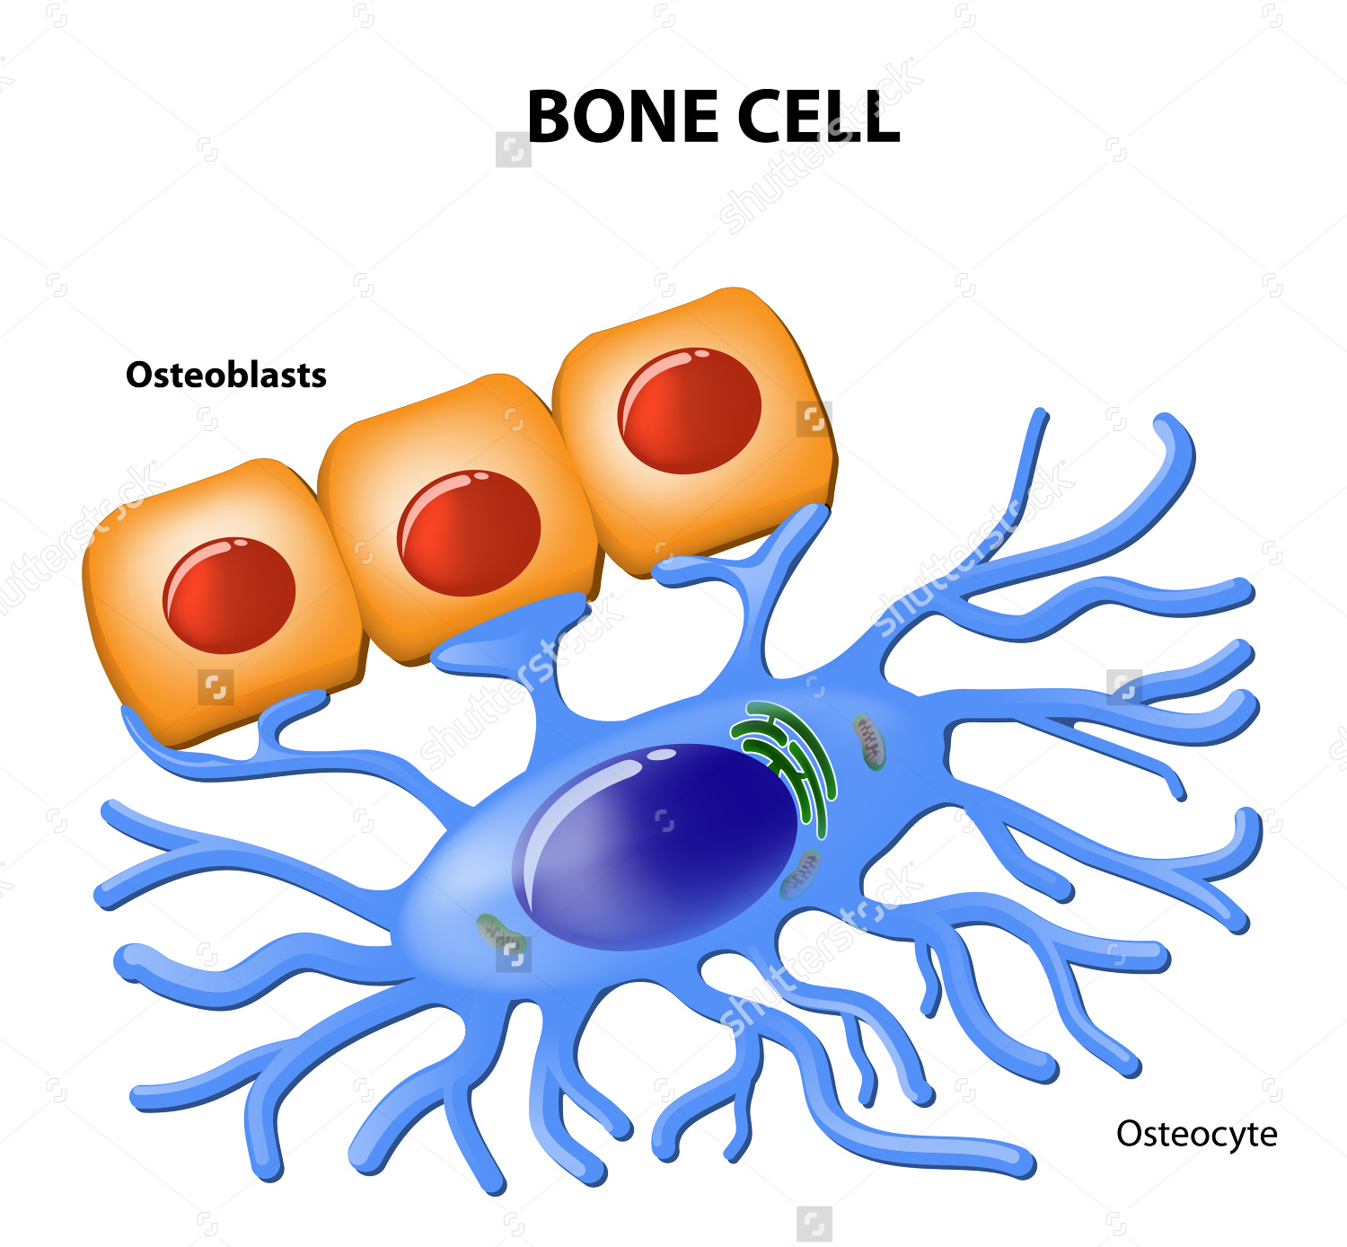
Somatic Mutations
Affects body cells
Only the individual is affected
Involved in cancerous growths

Slide 18
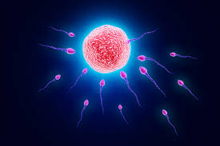
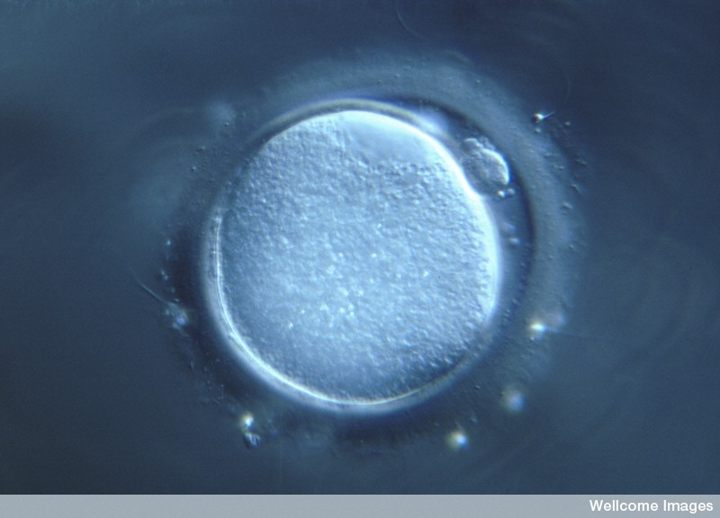
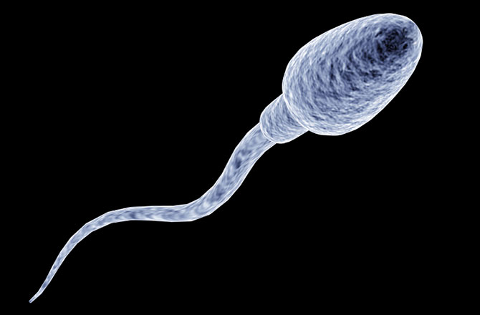
Germline mutations
Mutations occur in gamete cells
Individual normally not affected
Passed on to offspring
Affected embryos are naturally aborted
Eg. PKU

Slide 19
Quick quiz
What is the name given to a group of organisms of the same species living together in a particular place at a particular time?
Define a gene pool
What are the two main types of mutations?
Name one difference between somatic and germline mutations

Slide 20
Quick quiz
Population
The sum of all alleles in a given population
Gene and chromosomal
Somatic
individuals affected, occurs in body cells
Germline
offspring affected, occurs in gametes

